Slide 1
New Student Orientation
Fall 2017
*this presentation can be downloaded from the LACES website

Slide 2

Parents
  10:00-10:30- In the auditorium for general announcement
  10:30-11:45- Divide up with a LACES parent representative for and informational session. Then you will go on a student-led tour of the campus.
  11:45- Parents and students meet outside the student store
Students
  10:00-10:30- In the auditorium for general announcements
  10:30-11:45- Divide up with you homeroom for games, tours and other excitement!
  11:45- Meet your parents at the student store.
Notes:
Selig gives overview

Slide 3

Your Child’s Class Year
6th grade 2024
7th grade 2023
8th grade 2022
9th grade 2021
10 grade 2020
11 grade 2019
12 grade 2018

Slide 4
Welcome from the LACES Parent Liaisons
Tracy Cook: trabot@ca.rr.com
Holly Cantos: holly.cantos@gmail.com
Maggie Owen: maggieowen727@gmail.com
Heidi Rudd: heidi.rudd@LIVE.COM
Shonda Peterson: shondatpeterson@gmail.com
Jessica Dabney: Jdabney@northarmericanrealty.net
Cynthia Waldman: Cwaldman@pacbell.net
Seraphine Kinlow: seraphinekrm@gmail.com
Maria Rivas: mverorvs1@yahoo.com
Yeonsil Park: jnypark7@hotmail.com
Stacey Zedeck: sskura@yahoo.com

Slide 5

Who's Who at LACES?
Kimberly Lesure, Principal
Catalina Hwang, Assistant Principal
Marc Paez, Assistant Principal
Ellana Selig, Assistant Principal
Teresa Bomer, Magnet Coordinator
Marlon Shows, Dean
Notes:
Boger’s Slide

Slide 6
LACES 2017-2018 COUNSELORS
6th Grade
Marci Banner Ext. 5918 marci.banner@lausd.net
8th & 9th Grade
Denise Baldonado Ext. 5914 dab8950@lausd.net
10th & 12th Grade
Saray Reddick Ext. 5921 sad0700@lausd.net
7th & 11th Grade
Nicole Pratt Ext. 5930 nkp9273@lausd
College
Erika Lopez Ext. 5913 erika.a.lopez@lausd.net

Slide 7
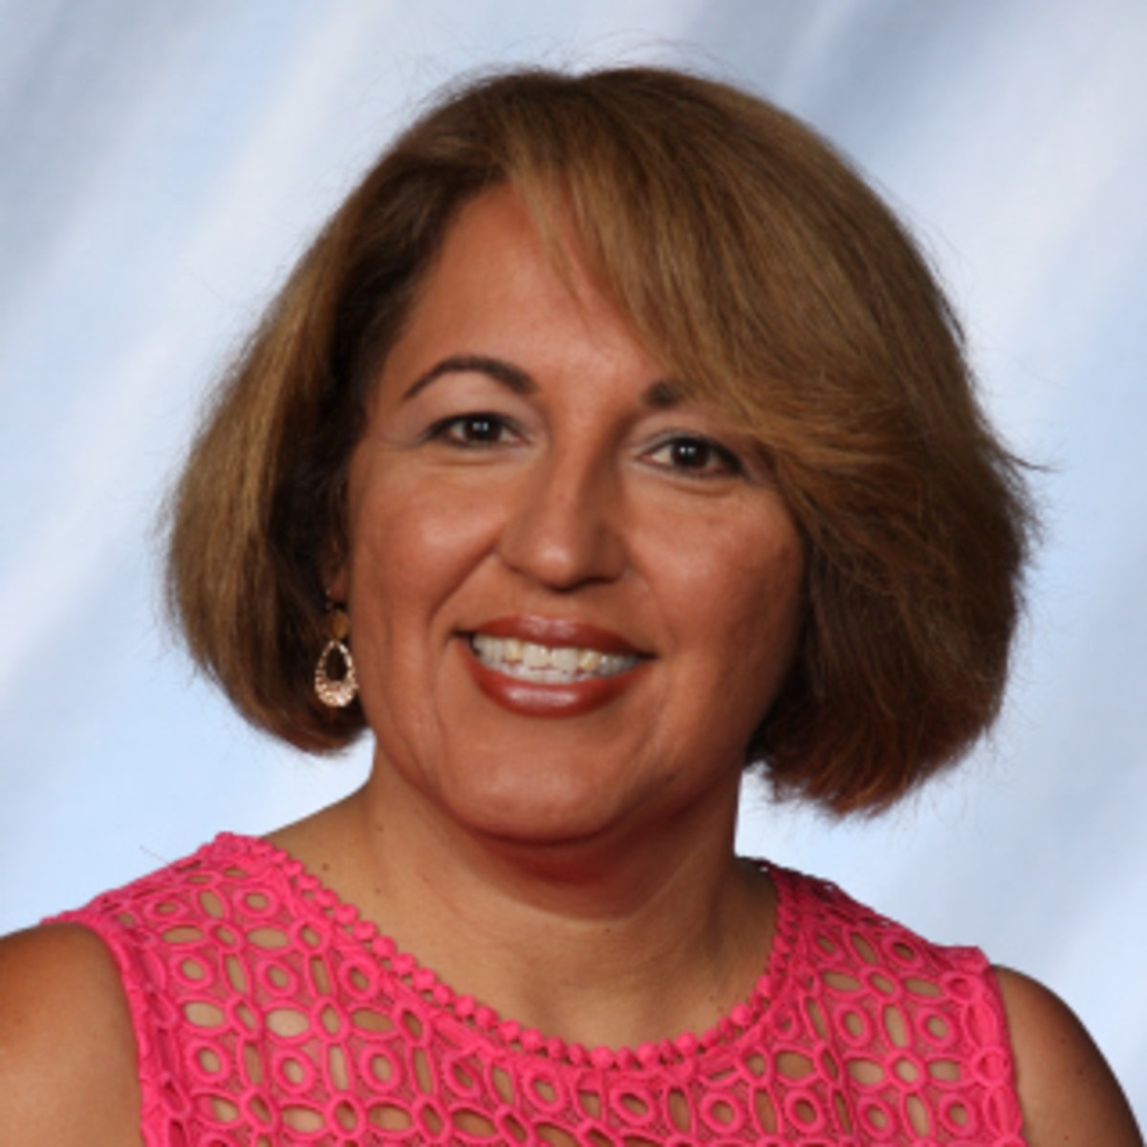
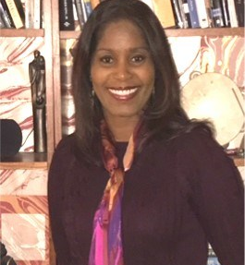
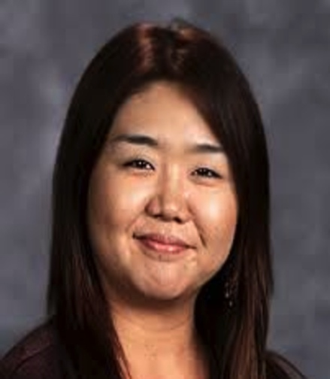
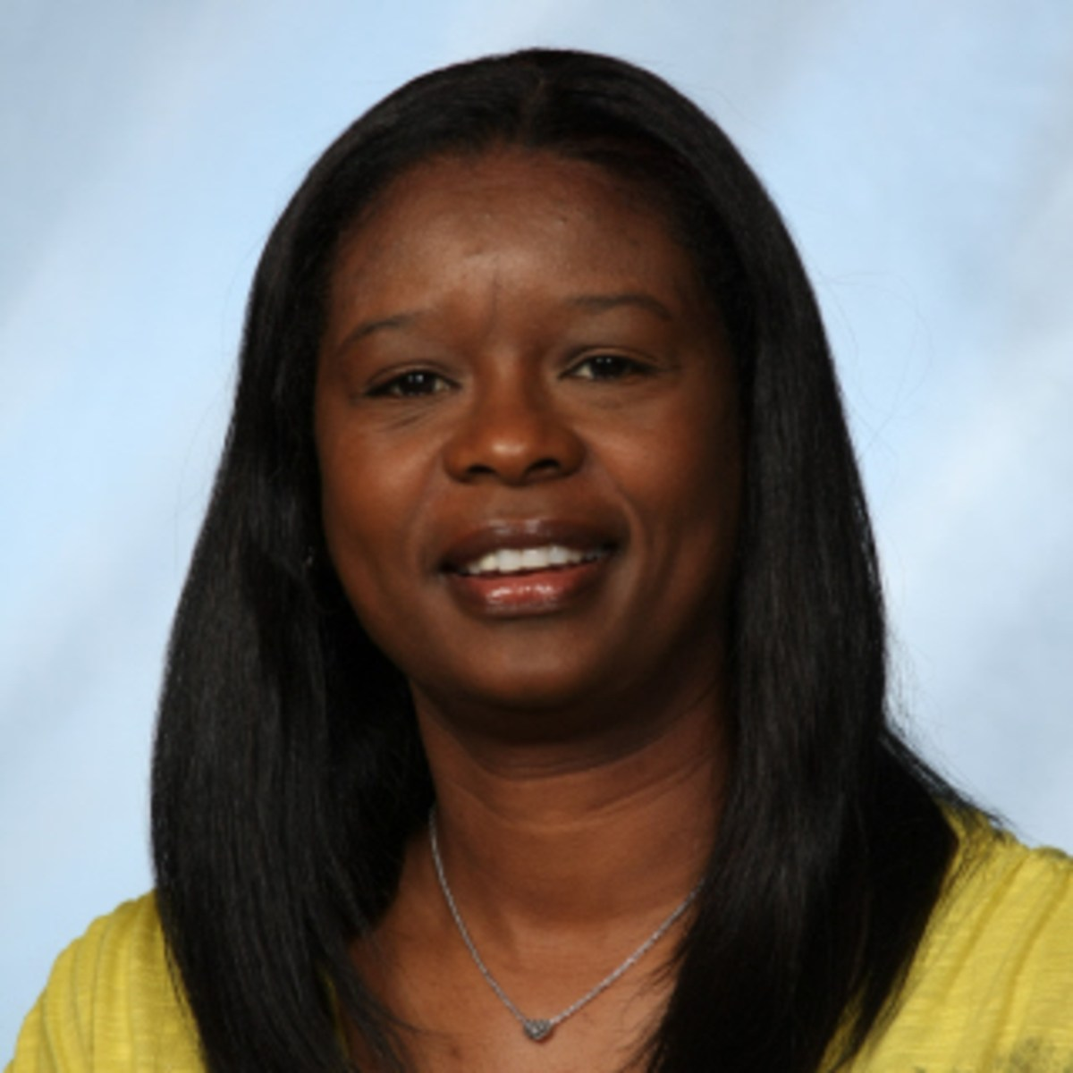
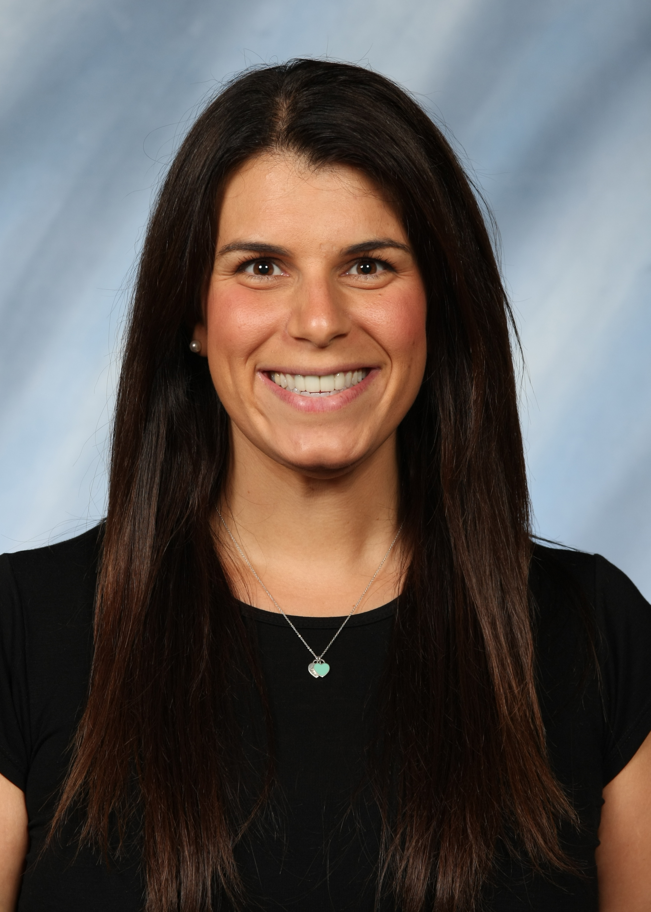
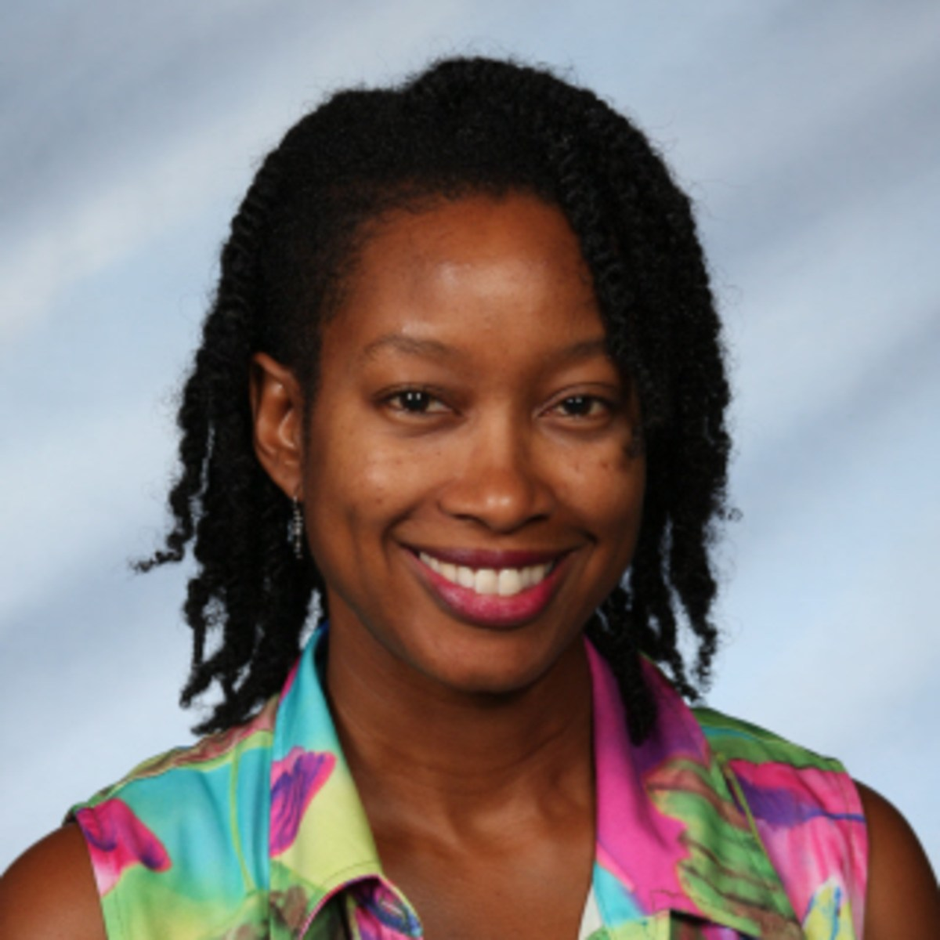

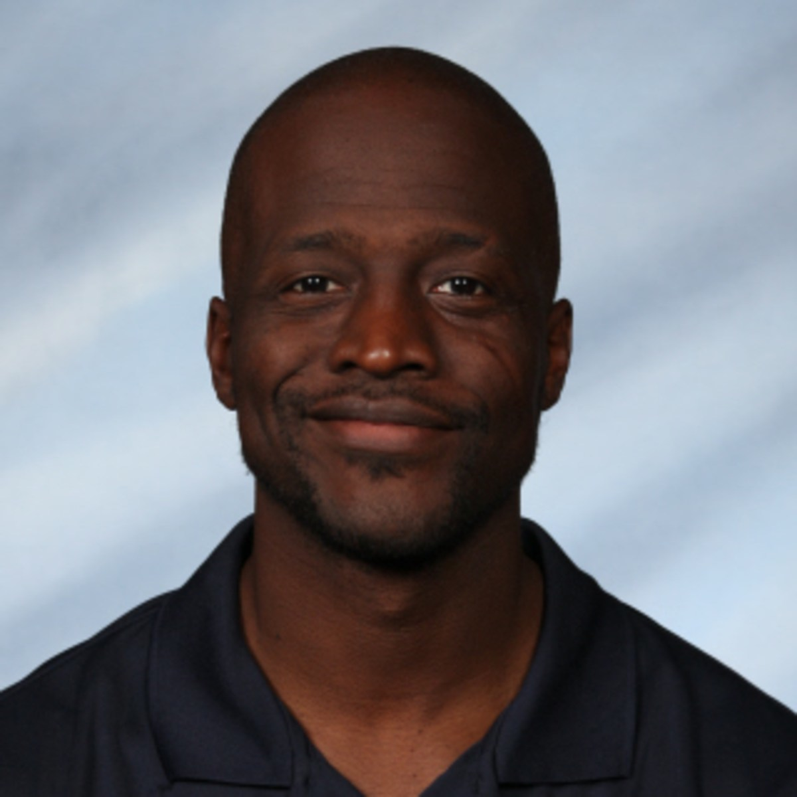
Ms. Baldonado
8th and 9th grade
Ms. Lesure
Ms. Hwang
Counseling Services
Ms. Bomer
Magnet and enrollment concerns
Ms. Selig
Attendance and Transportation
Ms. Reddick
10th and 12th grade
NHS
Mr. Paez
Physical campus concerns
Mr. Shows
Safety concerns and athletics

Slide 8

LACES 2017-2018
GRADE LEVEL DISCIPLINE SUPPORT:
6TH – Banner (5918) 9th/10th – Paez (5922)
7th/8th – Selig (5928) 11th/12th – Hwang (5917)
DEPARTMENT ADMINISTRATORS:
Lesure – Math, Performing Arts, Other Electives
Paez – Science, Culinary Arts (CTE), PE
Hwang – English, Resource/Special Ed., Health
Selig – Visual Art, Social Studies, World Language

Slide 9
The U-House Way
Be Respectful
Be Responsible
Be Ready
Notes:
Boger’s Slide- at the end of this slide, dismiss 6th graders

Slide 10

Schoology for Parents
Schoology Website
Notes:
Boger

Slide 11
SCHOOLOGY ACCESS
Parents will need to set up an account in the LAUSD Parent Passport Portal (passport.lausd.net). For information on how to do this go to. There is a video there that will walk you through the steps of setting up an account. (To complete the process you will need your child's District ID. If you do not know it, it can be found on your child’s schedule, LAUSD report card, or acceptance letter.
Students will be told today what they will need to do to gain access to Schoology.
Any important updates will be posted to the school's website.
Please keep Ms. Bomer’s contact for any Schoology related questions: tfiel2@lausd.net or (323) 549-5955

Slide 12
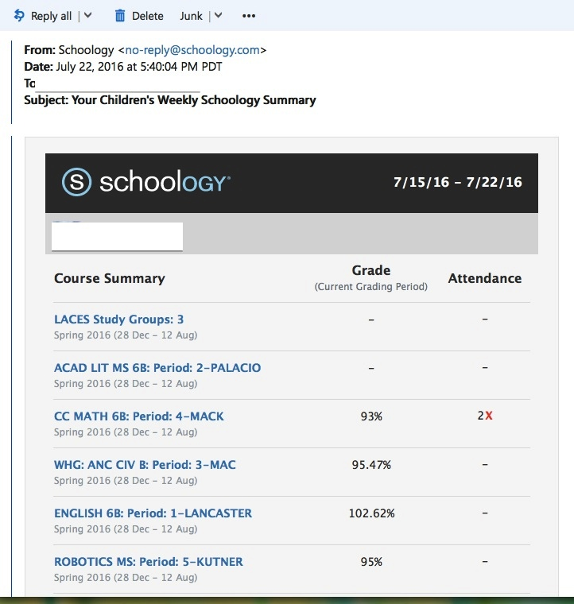
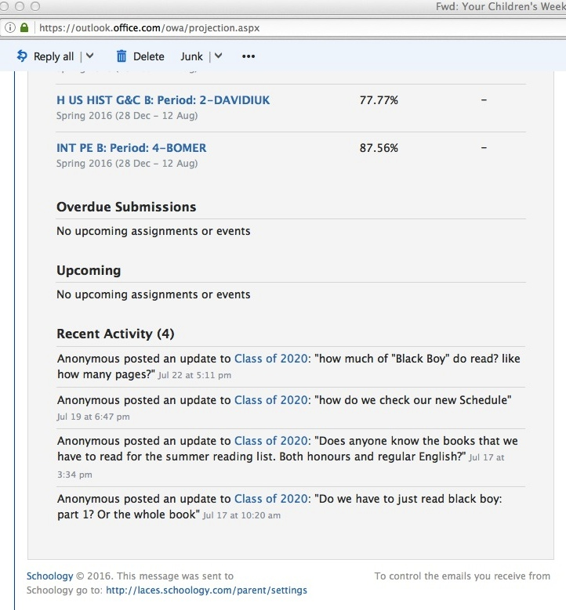
Weekly Schoology Emails

Slide 13
Schoology Groups
Get the most information our of Schoology by using access codes to join specific groups based on your child’s grade and community groups
Parent/Community Group: NDGJV-6HDW2
LACES BPO: GHSKH-DBVSS
LACES LPO: N89SS-VJRXS
LACES KPO: FCC5M-QQNSW
Parents of 2024 :F96VK-QMKBC
Parents of 2023: 8HCJQ-Q7D34
Parents of 2022: T95QH-TPZC7
Parents of 2021:RQ327-NBXGQ
Parents of 2020: F4DK5-FTNXT
Parents of 2019: KN5D4-HZ473
Parents of 2018: HC443-RRTKF

Slide 14

Transportation
-Ms. Selig
Most of our students are transported by bus from throughout the city
*(5 miles)
  Put child’s bus route in your wallet
  Bus Routes mailed home in August
  1-800-LA-BUSES
Notes:
MJ’s slide

Slide 15

Lockers
Students will receive their school lockers today.
Students also receive a PE locker within the first couple of weeks of school.
Please review locker safety with your child. They should only be sharing their combination with you.
Notes:
MJ-
Practice with a lock at home
Tip-putting your child’s combination in your phone so if they call you always have it

Slide 16

Challenges for New Students
5th graders have one teacher, one classroom
LACES students have seven teachers
  Each teacher has their own syllabus/classroom expectations
  Students learn to work with different personalities
Each class is over an hour long
  Students learn to extend their concentration time
Classes meet three times a week
Use a planner to stay organized

Slide 17

Transitional Programs
Sixth Grade Homeroom Leaders
  Older students greet them every day and help them with transitional issues
  Tutoring, friendship building activities
  Mentoring relationships
Big Brother Big Sister
Program through Leadership
Peer Helping assistance program
Strongly recommend that each child gets a phone number for at least one person in each class
  Homework buddy, assignments missed due to absence

Slide 18
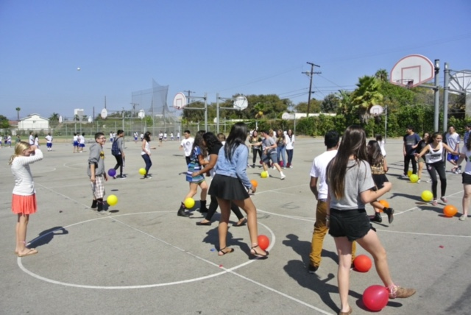
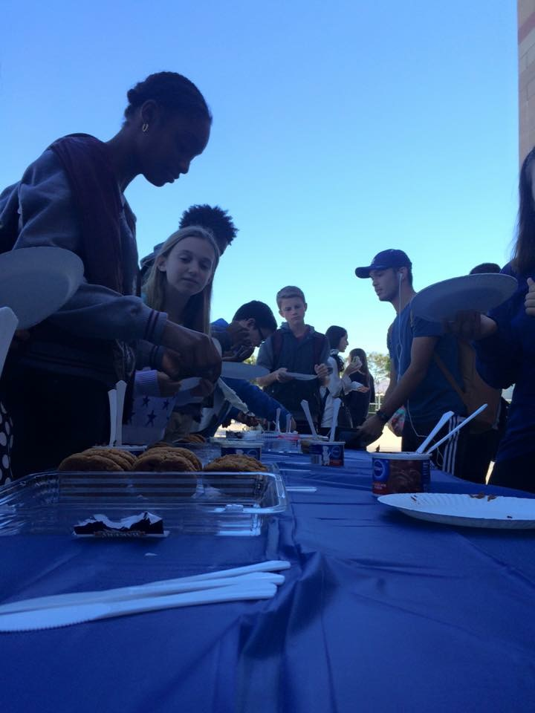
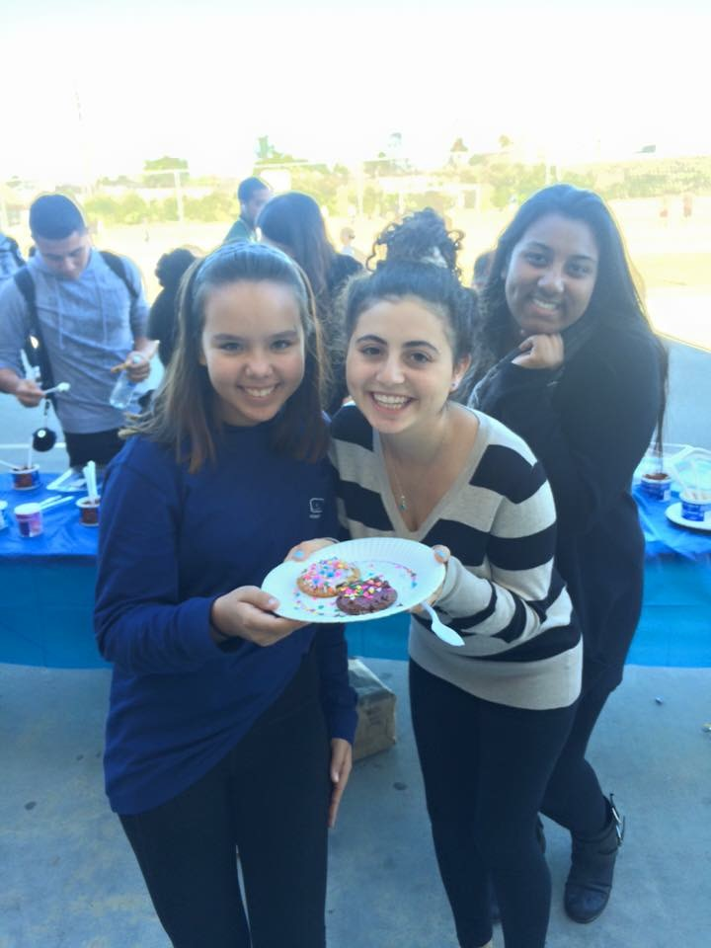
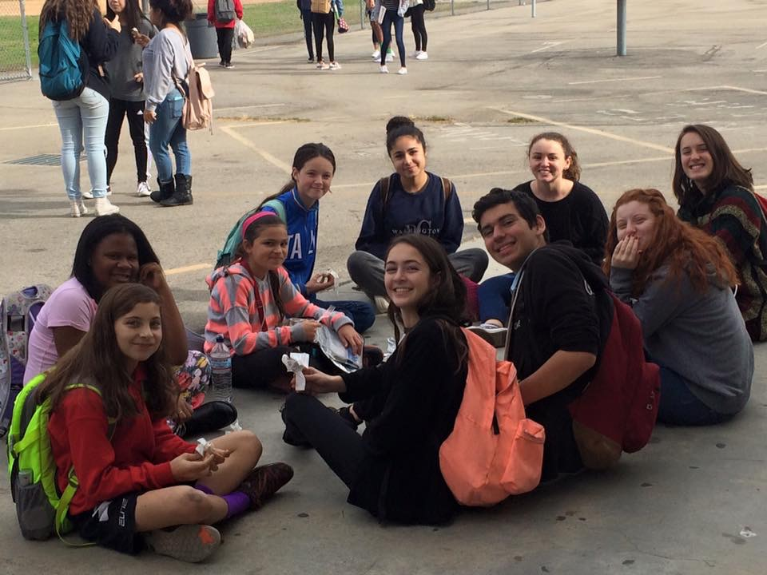
Photos from Big Brother Big Sister Events during the 2016-2017 school year.
Big Brother Big Sister is at lunch, no sign ups required. All 6th graders are welcome to attend!

Slide 19


PEER HELPING
The mission of the Peer Helping Program is to help young people develop into positive, healthy adults by training and empowering them as leaders who serve others, helping create a positive change at school and in the community.
We want to make sure that students feel welcomed and participate in a healthy, safe, and accepting environment at LACES. Because Peer Helpers understand that students face trials throughout middle and high school, Peer Helpers know that it takes dedication, respect, and empathy to help guide students through a challenge they may be facing.
Students can refer themselves to Mr. Contreras, our class advisor. Teachers, parents, counselors, and school administration have the ability to refer students to our program. Please contact Mr. Contreras for more information.

Slide 20

Activities
LACES Clubs
Study Groups
Beyond the Bell*

Slide 21

2016-2017 6th Grade Intervention and Study Groups
MONDAY
Leadership Tutoring 3:15-5:15 Room 161 Contact: Moore
6th Grade History 3:15 -5:15 Room 204 Contact: Mac
Math Tutoring 3:15-5:15 Room 135 Contact: Ms. Best
WEDNESDAY
6th Grade History 3:15 -5:15 Room 204 Contact: Mac
6th Grade Tutoring 3:15-5:15 Room 226 Contact: Sampah
THURSDAY
Math Study Groups 3:15-5:15 Room 135 Contact: Munoz
6th Grade Tutoring 3:15-5:15 Room 125 Contact: Ikuma

Slide 22
2016-2017 After School Academic Interventions
MONDAY
Leadership Tutoring 3:15-5:15 Room 161 Contact: Moore
6th Grade History 3:15 -5:15 Room 204 Contact: Mac
Math Study Groups 3:15-5:15 Blue Bldg. 1st Fl. Contact: teacher
World History Study Group 3:15-5:15 Library Contact: Horton
8th Gr. U.S. History Tutoring 3:15-5:15 Room 126 Contact: Davidiuk
HS English Credit Recovery 3:15-5:15 Room 123 Contact: Topkis
(Enrolled students only)
WEDNESDAY
Science Study Groups 3:15-5:15 Blue Bldg. 2nd Fl. Contact: teacher
6th Grade History 3:15 -5:15 Room 204 Contact: Mac
World History Study Group 3:15-5:15 Library Contact: Horton
HS English Credit Recovery 3:15-5:15 Room 123 Contact: Topkis
(Enrolled students only)
NHS Tutoring 3:15-5:15 Room 229 Contact: Reddick
6th Grade Tutoring 3:15-5:15 Room 226 Contact: Sampah-Stewart
(Homework Help all subjects)
THURSDAY
Math Study Groups 3:15-5:15 Blue Bldg. 1st Fl. Contact: teacher
World History Study Group 3:15-5:15 Library Contact: Horton
Foreign Language Tutoring 3:15-4:15 Teacher’s room Contact: teacher
English Learner (E.L.) 3:15-4:15 Room 122 Contact: Lancaster
(Need based ELA tutoring) JXL4414@lausd.net

Slide 23

Classes
Sixth graders take seven classes.
Math, Science, History, English, P.E., Academic Literacy and one elective
Seventh Graders will get to take two electives
Eighth Graders will get to take two electives
Electives are tentative.
  Some may change due to staffing or student interest.
  You don’t always get your first choice

Slide 24
LACES Website and Schoology
Great places to visit for lots of important information:
www.lacesmagnetschool.org
www.schoology.com
passport.lausd.net

Slide 25

FOL Facebook Groups
Friends of LACES LACES2018
LACES2019
LACES2020
LACES2021
LACES2022
LACES2023
LACES2024
All are closed groups. Users should search for the group by name, and ask to be added.
Anyone may contact Holly Cantos at holly.cantos@gmail.com if there are any issues with joining.

Slide 26
Parent Involvement
*see handout
Who is FOL?
Friends of LACES is the parent group for LACES. FOL works with Principal Lesure, teachers, staff and fellow parents to support the LACES students. As a parent at LACES, you are already a member of FOL. FOL relies on parent volunteers and donations to give LACES all it needs to remain a top performing school. Find us on Facebook! Search Friends of LACES and join our group.
Fundraisers & Donations
Parents donate in the fall to the Annual Giving Campaign (AGC). This is the largest fundraiser for FOL. Spring Gala is in March/April. Parents are asked to donate items for the drawings/silent auction, attend & bid. LACES Big Eat- Two family dinner nights a year. One night, five restaurants, pick the restaurant closest to home & meet each other while eating dinner. Proceeds go to FOL. Grade Level Donation- Each spring parents donate to their Class Account. That money will help offset some costs of the senior activities, such as prom, senior picnic, security, etc. Also there is $200 senior dues for the graduation costs in senior yr.
Reduced & Free Lunch
All families regardless of income should fill out form for reduced & free lunch. If you qualify, your child will receive a free lunch and LACES receives federal funding.
MSAM
Middle School Action Meetings are the first Friday of each month. 6th,7th,8th grade parents meet & discuss ideas and programs for Middle School and beyond.
Community Building
BPO Black Parent Organization & LPO Latino Parent Outreach & KPO Korean Parent Organization
Volunteering
All parents are asked to volunteer in Car Line. No one would be able to drop off at LACES if it were not for car line. Your child’s grade determines the month you volunteer. We need your help!

